Slide 1
Compound Statements & Nested Selection
T-levels

Slide 2
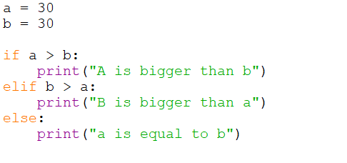
previously

Slide 3
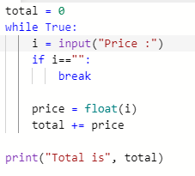
The break keyword will break out of a loop

Slide 4
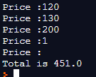

Slide 5
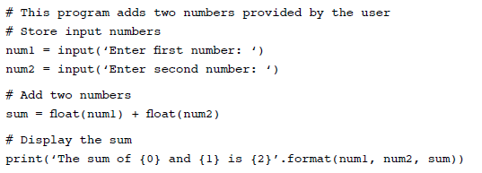
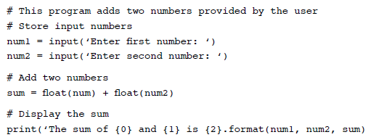
There are 3 mistakes, can you spot them?

Slide 6
Today
Look at compound statements and how they can refine if statements
Look at nested selection
Extend Python programming skills

Slide 7
Previously
Input (using the …. Input() statement)
Output (using the print() statement)
Variables
int (integer)
float (floating point number)
str (string of characters / text)
Casting – changing the type of a variable

Slide 8
Casting – why?
Why do we need to know the type of a variable?
Will affect the operations that can be performed on it
1 + 1 = 2
“1” + “1” = “11”
1.5 + 1.5 = 3.0
Mathematical addition or string concatenation

Slide 9
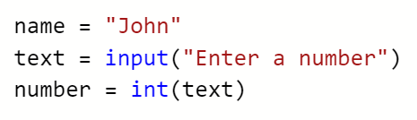

Info on this slide is NOT needed to pass the course, it is NOT in the exam
MEMORY
99
9
9
2
n
h
o
J
4
number
text
String layout in Python is (more or less) size, characters there are some technical complications that are not important (Unicode wchar_t (2 bytes) + header info)
name

Slide 10
boolean
Another data type: Boolean
True
False
Used in Boolean expressions – if elif

Slide 11

What is the value stored in a, b and c?
John – use a random name picker

Slide 12
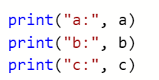


Slide 13
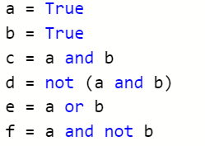

Slide 14



Slide 15
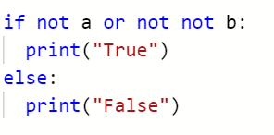

Slide 16


Slide 17
Last time…
Previously, we looked at:
If statements
If else statements
Else if statements

Slide 18
Selection
What is the purpose of an “if else” statement?

Slide 19
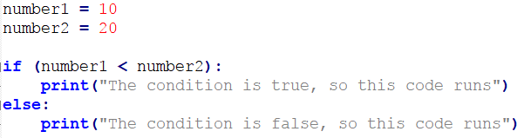
What is the purpose of an “if else” statement?
To offer choices in programs
A condition is tested, if it evaluates to “true” the if code is run…
…if it is false, the “else” code is run.
Super duper important bits:
The colon: : .. ::: . ::.::. :
The indentation!
Block

Slide 20
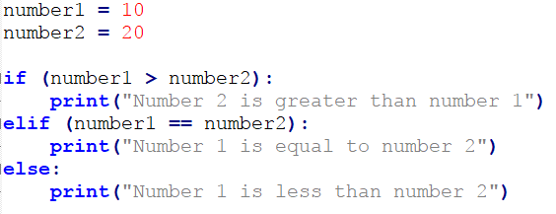
Elseif (elif)
The use of an elif allows for many conditions to be checked…
…once the true condition is found, the associated code runs.
If none of the conditions are true, the else statement code is run.
You can chain together as many elif statements as needed.

Slide 21
Compound Statements
We can add even more precision to if statements…
Compound statements allow for more detailed conditions.
if (condition is true) and (condition is true) :
print(“Both are true”)
else:
print(“One or both are false”)
Let’s look at an actual example…

Slide 22
First…
Can you tell me what is happening in this statement:
numberChoice = int(input(“Please enter a number between 10 and 20:”))

Slide 23
First…
Can you tell me what is happening in this statement:
numberChoice = int(input(“Please enter a number between 10 and 20:”))
The user is asking to input a whole number…
…whatever they type in will be stored as an integer…
In a variable with an identifier of numberChoice.

Slide 24
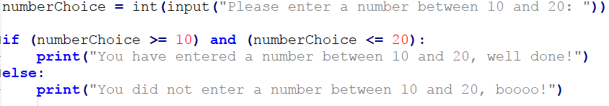
If statement with a compound statement
There are other types of compound statement…

Slide 25
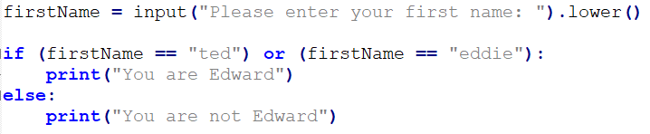
Logical operator - or
OR:
Checks to see if either of the conditions are true.
Only one on or the other needs to be true for the if code to run.

Slide 26
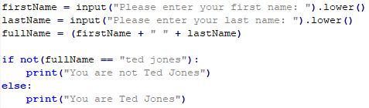
Logical operator - not
Not:
You have probably noticed that the same could be achieved by:
if (fullName != "ted jones")
Matter of personal choice which way you prefer to code it.

Slide 27
Summary
Compound statements allow for more precise selection (if statements)
You can “chain” together as many conditions as you like…
…using logical operators:
and
or
not
The not operator is rarer and can take longer to understand!

Slide 28
Logic examples
Dishwasher code
if door is shut AND start pressed:
If NOT door_shut: print(“Please close door”)
Light switches
Hall lights
Car warning beep
My car beeps if the lights are on, or the radio is on, or the doors are open
Can you think of examples for AND OR and NOT?

Slide 29
Questions
Any questions about compound statements or logical operators?

Slide 30
Nested Selection
We can also put if statements inside other if statements.
Sounds strange but can be quite useful, lets look at an example:

Slide 31
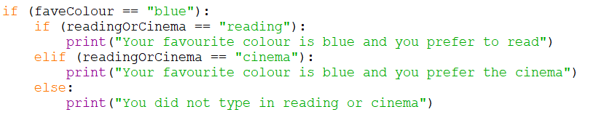
Nested if statement
In this example…
…if the users favourite colour is blue…
…the nested if statement code is executed.
If the user’s favourite colour is not blue, the nested if is ignored.

Slide 32
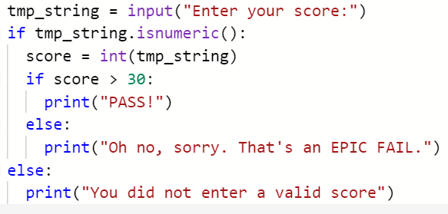
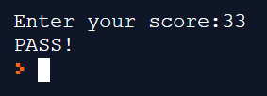

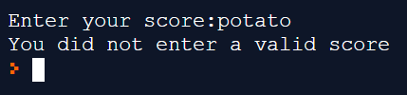

Slide 33
Nested selection
Offers even more precise decisions in code.
They can soon become confusing, so…
…plan the logic out beforehand…
Don’t just keep adding to them if you have not planned them out beforehand.
Once planned, conduct a “dry run” of the code…

Slide 34
Dry Run
Once you have planned out the nested if statement work through it manually.
Choose a result, then work though the options that should achieve that outcome.
If the outcome is not what you expected, the logic of the if statement is no correct.
All of this should be done on paper, before actually coding it.
Why do you think it is wise to do this on paper before coding?
Coding can be a frustrating experience…
…blindly typing code and hoping it works usually leads to irritation…
…and throwing the computer of the nearest window.

Slide 35
Activities
There is an activity sheet on OneNote to practice compound statements and nested selection in Python
Make sure that you understand what each task is asking you to do
Don’t move on to the next task until you understand the logic behind the earlier tasks.
Comment your code – leave yourself notes and reminders about what the code does.

